Slide 1

Serial Manipulator Dynamics
Kafrelshiekh University
Mechanical Engineering Department
Mechatronics Program
Lagrangian Formulation using MATLAB
Eman M.ElRify
Supervisor: Prof. Roshdy Abo-Shanab
Course: Industrial Robots Dynamics , Control and Simulation
Code: 40143

Slide 2

Outlines
Introduction
Collecting Data
Forward Kinematics
Jacobian Submatrices
Manipulator Inertia Matrix
Velocity Coupling Vector
Gravitational Vector
Results

Slide 3
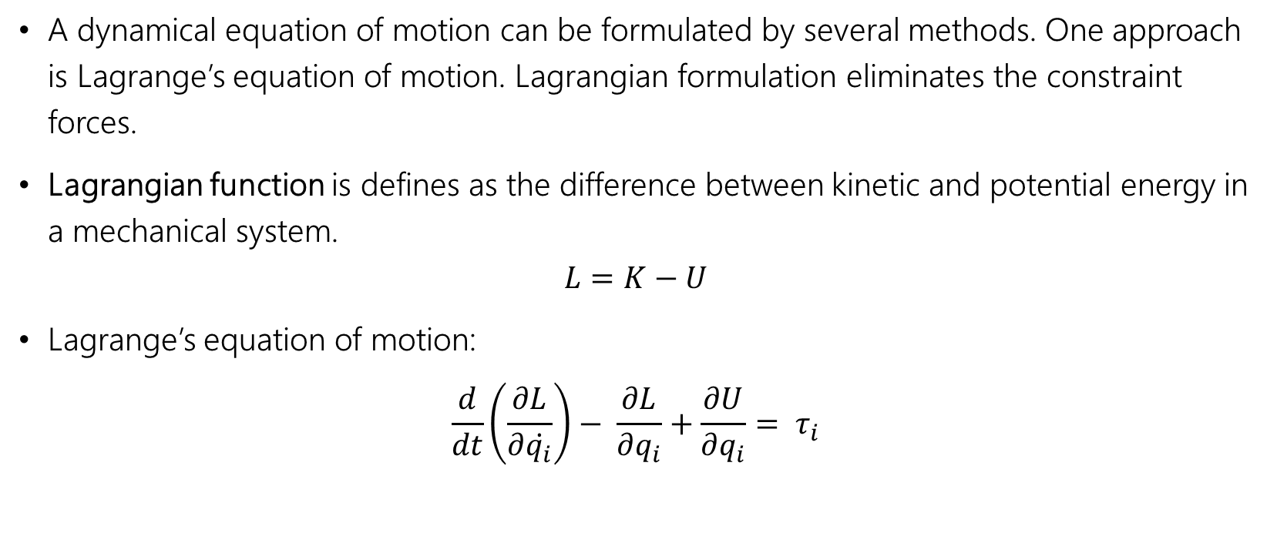
Introduction
A dynamical equation of motion can be formulated by several methods. One approach is Lagrange’s equation of motion. Lagrangian formulation eliminates the constraint forces.
Lagrangian function is defines as the difference between kinetic and potential energy in a mechanical system.
$$L=K−U$$
Lagrange’s equation of motion:
$$\frac{d}{dt}\left(\frac{∂L}{∂\dot{q_{i}}}\right)− \frac{∂L}{∂q_{i}}+\frac{∂U}{∂q_{i}}= τ_{i}$$

Slide 4
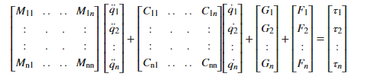
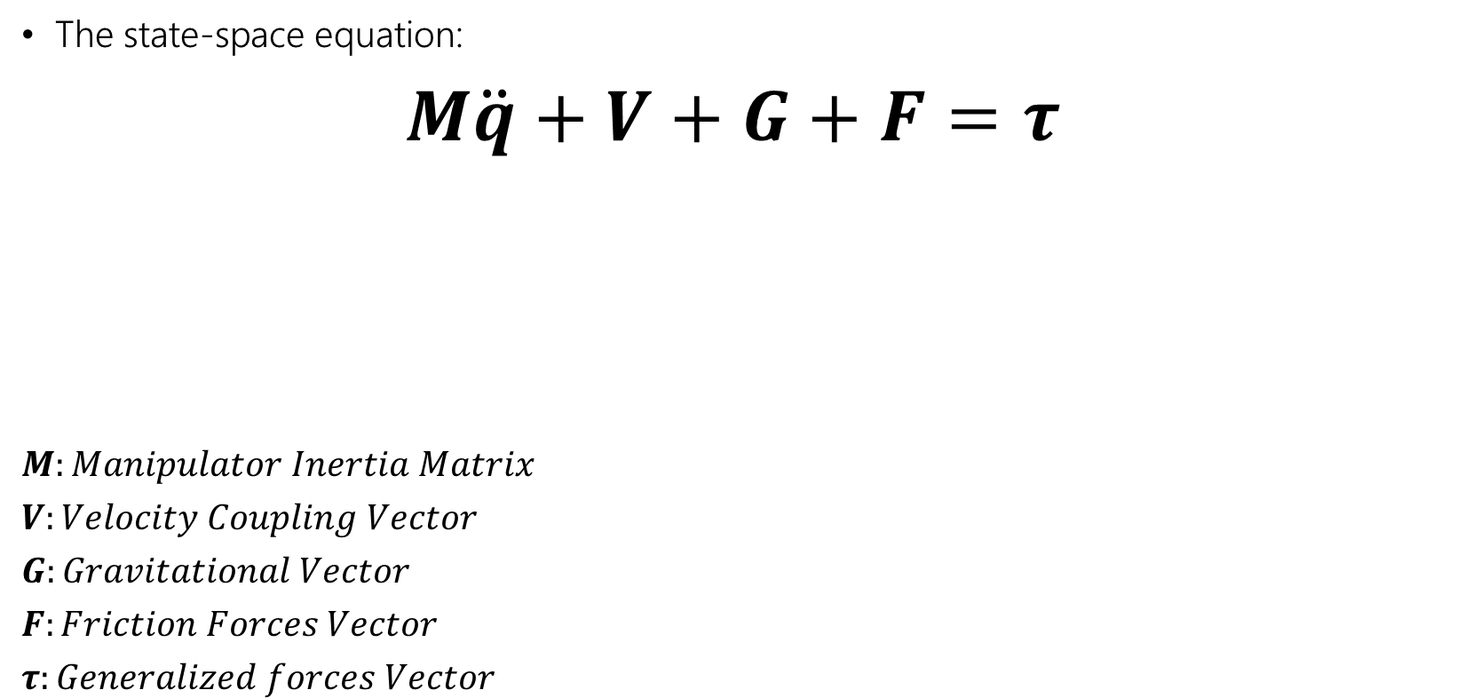
Introduction
The state-space equation:
$$M\ddot{q}+V+G+F=τ$$
$$M:Manipulator Inertia Matrix$$
$$V:Velocity Coupling Vector$$
$$G:Gravitational Vector$$
$$F:Friction Forces Vector$$
$$τ:Generalized forces Vector$$

Slide 5


Introduction
Assumptions
Resistance forces are neglected:
Each link has a rectangular surface and cross-section area
$$I_{i}=\frac{1}{12}m_{i}a_{i}^{2}\left[\begin{matrix}(w_{i}^{2}+h_{i}^{2}) & 0 & 0 \\ 0 & (a_{i}^{2}+h_{i}^{2}) & 0 \\ 0 & 0 & (w_{i}^{2}+a_{i}^{2})\end{matrix}\right]$$
$F=\left[\begin{matrix}0 \\ 0 \\ \begin{aligned}⋮ \\ 0\end{aligned}\end{matrix}\right]$ $M\ddot{q}+V+G=τ$

Slide 6

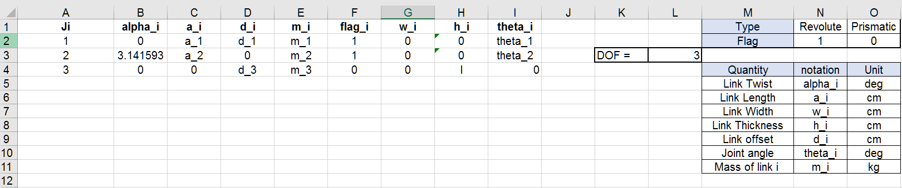
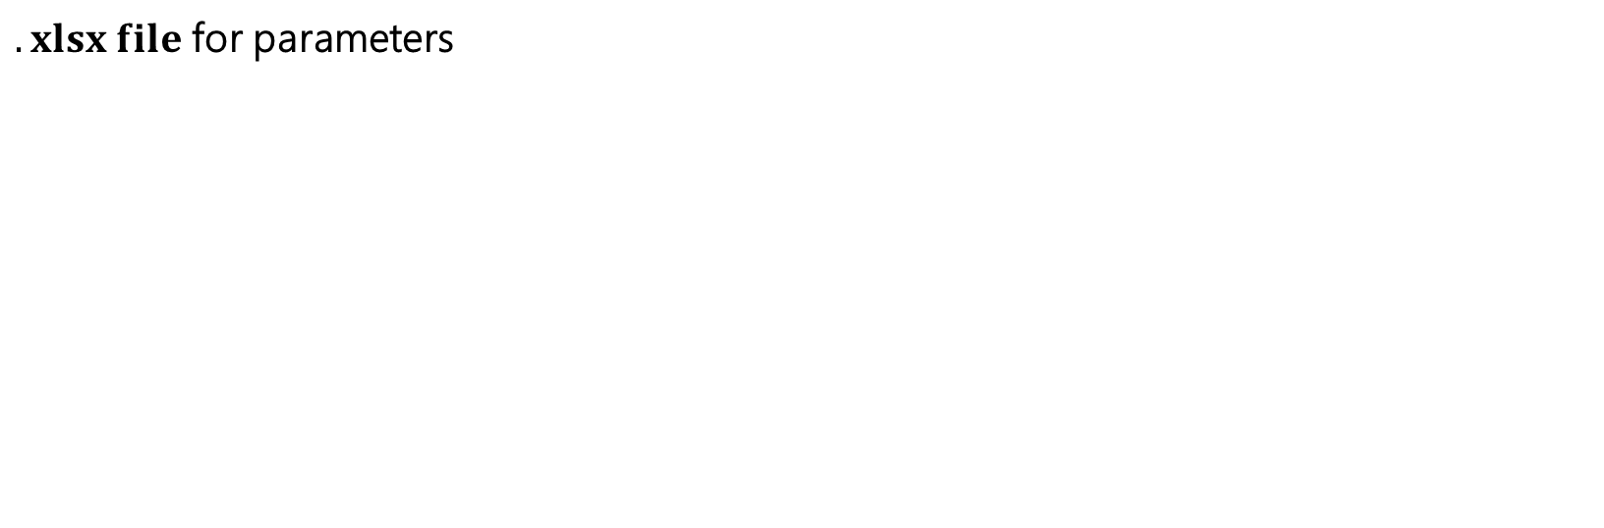
Collecting Data
$.xlsx file$ for parameters
SCARA Robot Parameters
Note : the shots in this PowerPoint file is taken after the execution of the program with the above parameters

Slide 7
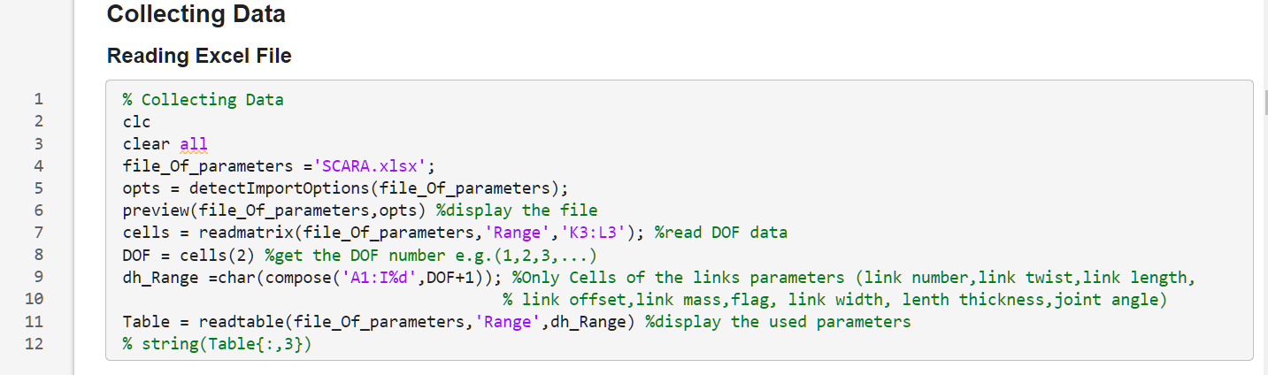

Collecting Data
$Paremeters are introduced to MATLAB by reading$ .xlsx file

Slide 8
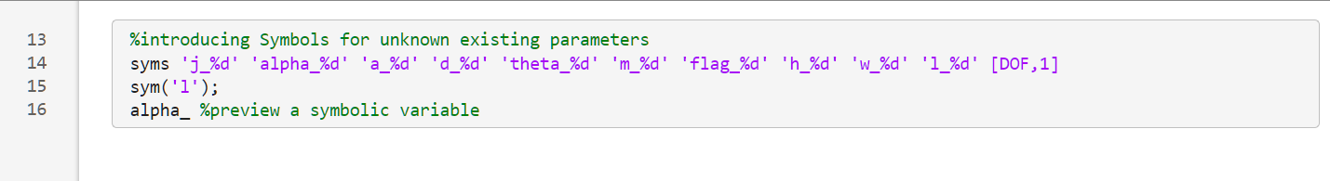
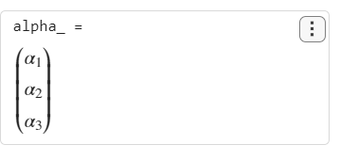

Collecting Data
$$Introducing Symbols for the non−numeric values$$

Slide 9
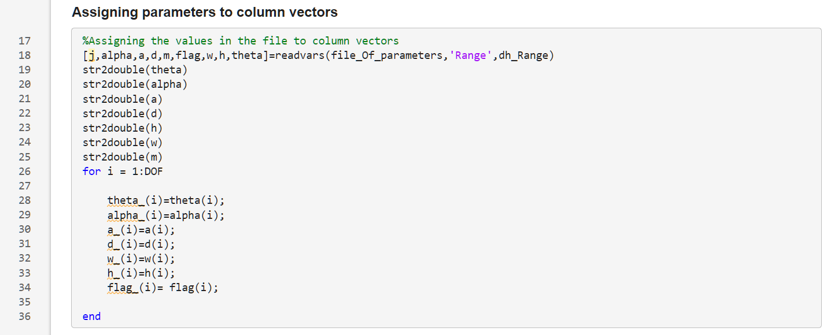

Collecting Data
$$Assigning parameters to column vector and conerting data type$$

Slide 10
Collecting Data
$$Assigning parameters to column vector and conerting data type$$
Read data as a column vectors
Converting string data type into double
Assigning values to the symbolic functions

Slide 11
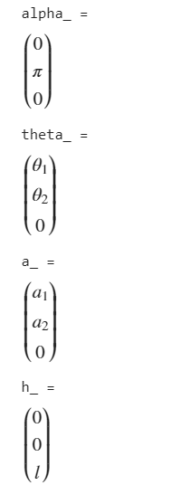
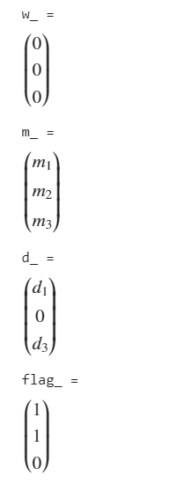
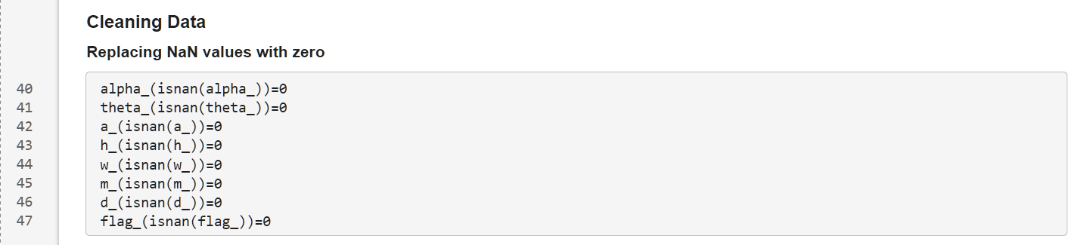

Collecting Data
$Cleaning Data$ (Replacing NaN values with 0)

Slide 12
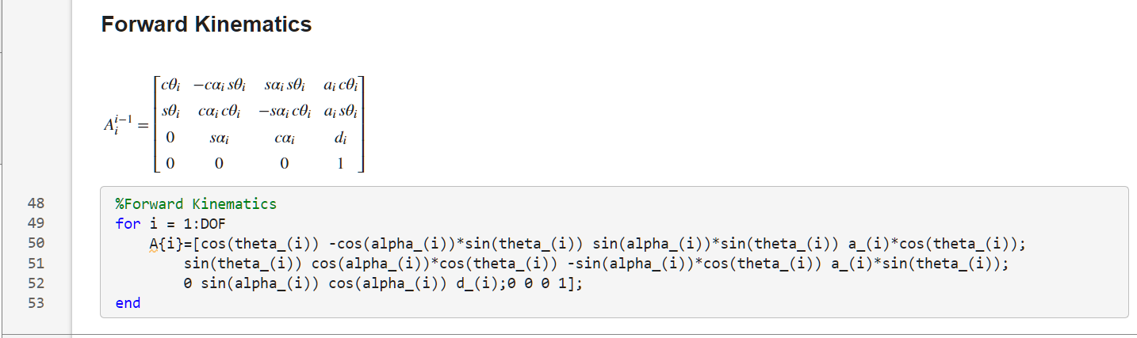
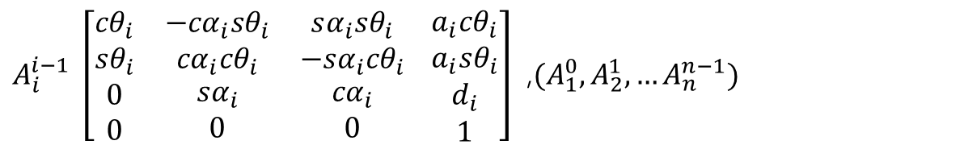
Forward Kinematics
$A_{i}^{i−1} \left[\begin{matrix}{cθ}_{i} & −{cα}_{i}{sθ}_{i} & sα_{i}{sθ}_{i} \\ sθ_{i} & {cα}_{i}{cθ}_{i} & {−sα}_{i}{cθ}_{i} \\ \begin{aligned}0 \\ 0\end{aligned} & \begin{aligned}{sα}_{i} \\ 0\end{aligned} & \begin{aligned}{cα}_{i} \\ 0\end{aligned}\end{matrix} \begin{matrix}a_{i}{cθ}_{i} \\ a_{i}{sθ}_{i} \\ \begin{aligned}d_{i} \\ 1\end{aligned}\end{matrix}\right]$ ,${(A}_{1}^{0},A_{2}^{1},…A_{n}^{n−1})$
D-H Transformation Matrix:

Slide 13
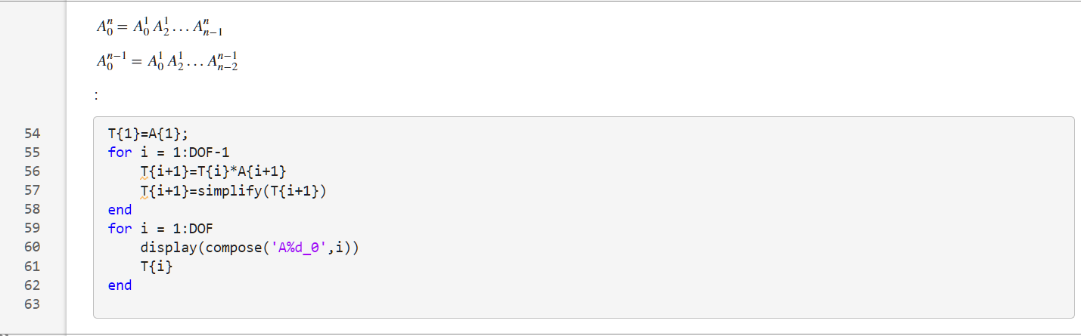
Forward Kinematics
Calculating: $A_{1}^{0},A_{2}^{0}…A_{n}^{0}$ $A_{n}^{0}=A_{1}^{0}A_{2}^{1}…A_{n}^{n−1}$

Slide 14
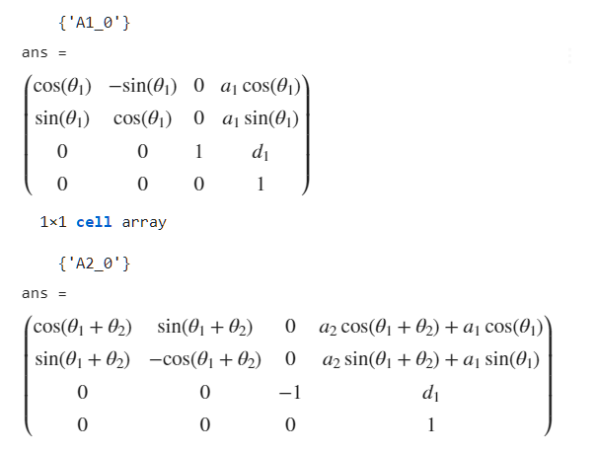
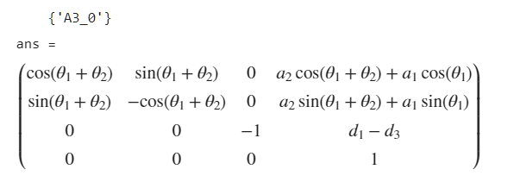
Forward Kinematics
Calculating: $A_{1}^{0},A_{2}^{0}…A_{n}^{0}$ $A_{n}^{0}=A_{1}^{0}A_{2}^{1}…A_{n}^{n−1}$
Result:

Slide 15
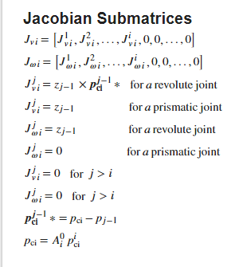
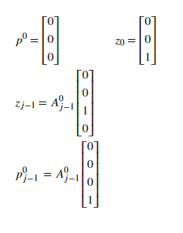
Jacobian Submatrices

Slide 16
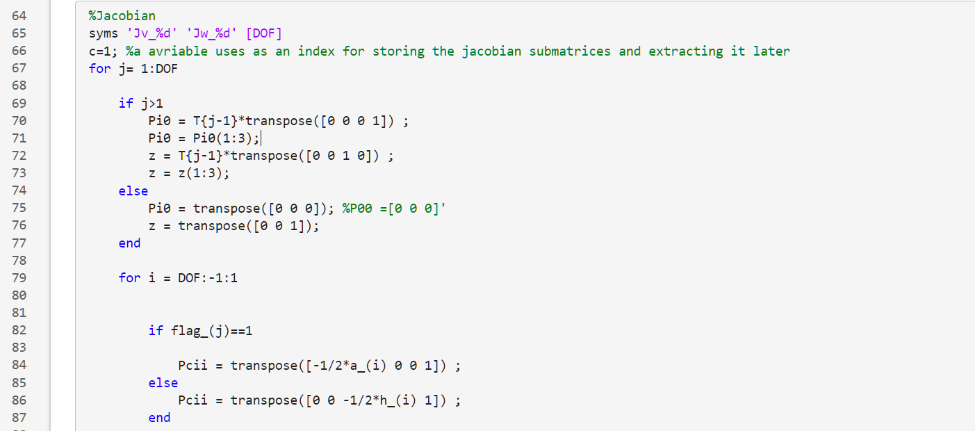
Jacobian Submatrices

Slide 17

Jacobian Submatrices
$$set initial value for P_{j−1}^{0}$$
$$P_{0}^{0}=\left[\begin{matrix}0 \\ 0 \\ 0\end{matrix}\right]$$
$$and for z_{j−1}$$
$$z_{0}=\left[\begin{matrix}0 \\ 0 \\ 1\end{matrix}\right]$$

Slide 18
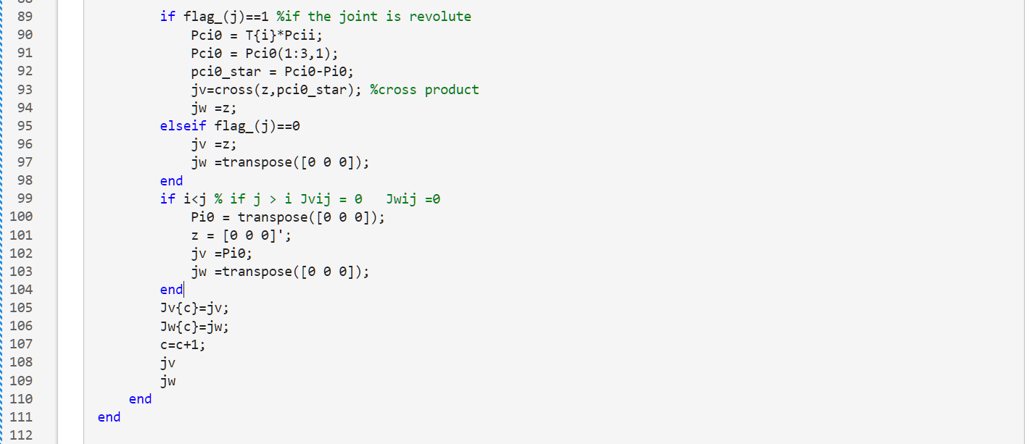
Jacobian Submatrices

Slide 19
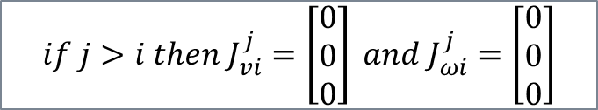
Jacobian Submatrices
$$if j>i then J_{vi}^{j}=\left[\begin{matrix}0 \\ 0 \\ 0\end{matrix}\right] and J_{ωi}^{j}=\left[\begin{matrix}0 \\ 0 \\ 0\end{matrix}\right]$$

Slide 20
Jacobian Submatrices
Creating an array with the Jacobian vectors

Slide 21
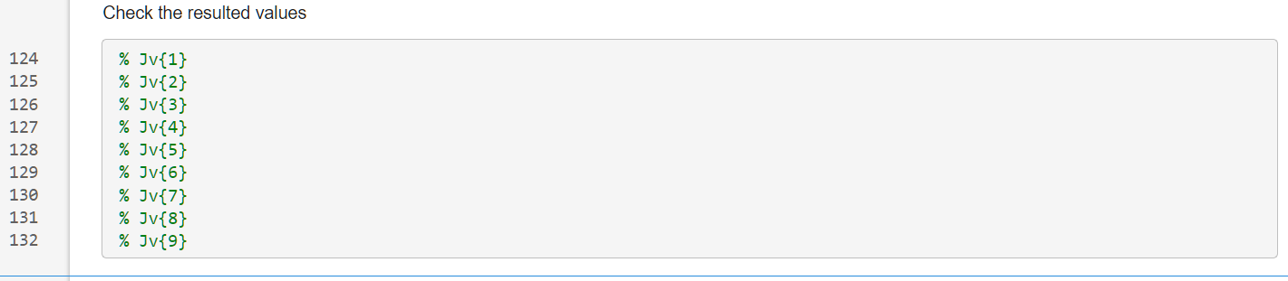
Jacobian Submatrices
Set of matrices in particular order resulted from the loop

Slide 22
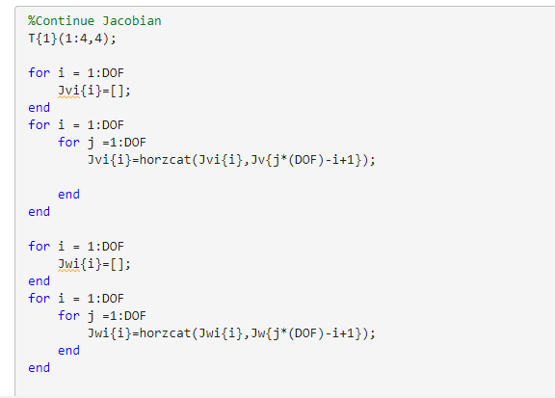

Jacobian Submatrices
Concatenating the vectors in one single array for each link i

Slide 23
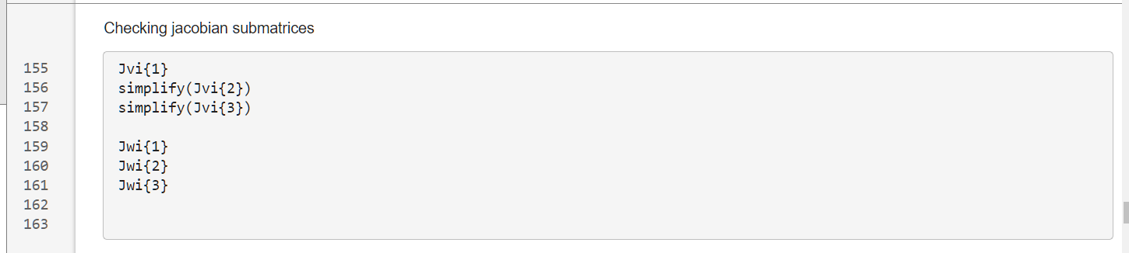
Jacobian Submatrices
Checking the Jacobian Matrix for each link

Slide 24
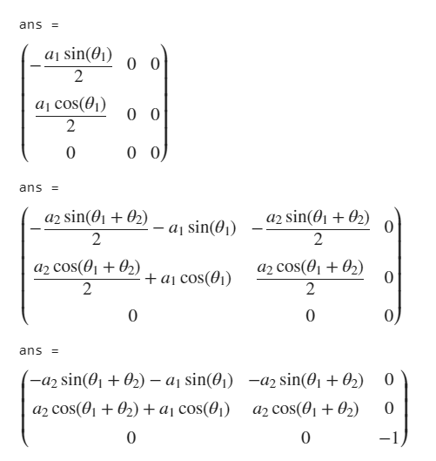
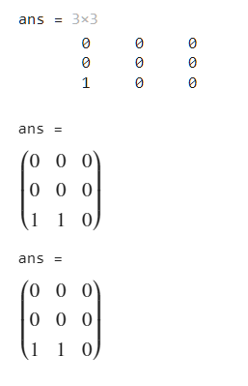
Jacobian Submatrices
Checking the Jacobian Matrix for each link

Slide 25

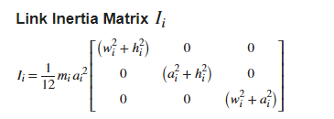
Manipulator Inertia Matrix

Slide 26
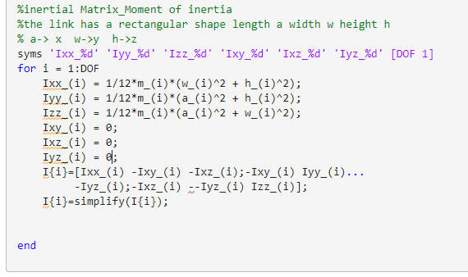
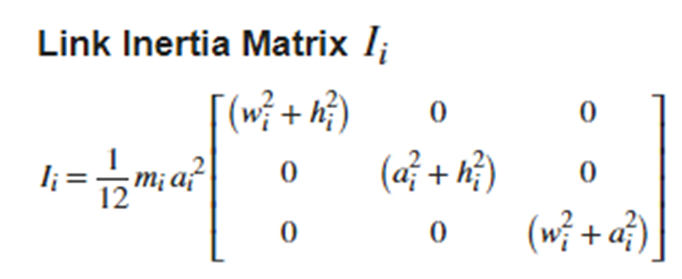
Manipulator Inertia Matrix

Slide 27
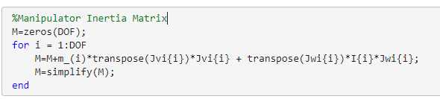
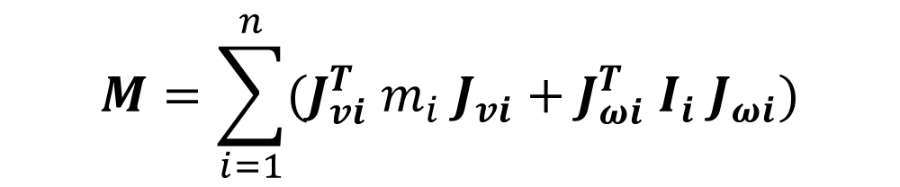
Manipulator Inertia Matrix
$$M=\sum_{i=1}^{n}{(J_{vi}^{T} m_{i} J_{vi}+J_{ωi}^{T} I_{i} J_{ωi})}$$

Slide 28
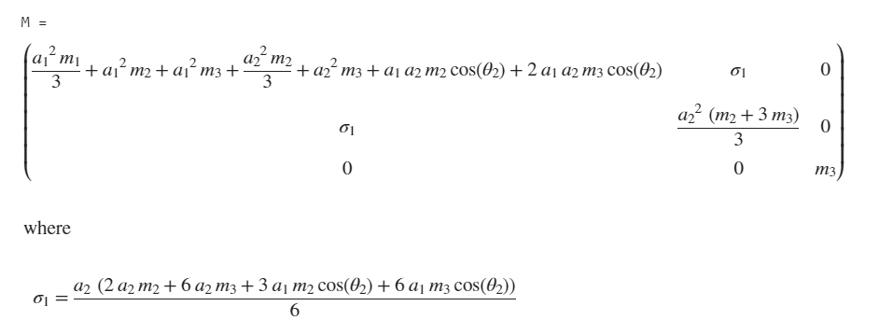
Manipulator Inertia Matrix
$$M=\sum_{i=1}^{n}{(J_{vi}^{T} m_{i} J_{vi}+J_{ωi}^{T} I_{i} J_{ωi})}$$

Slide 29
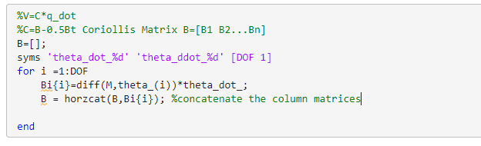

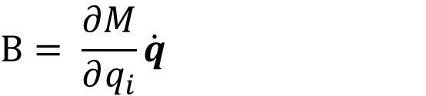
Velocity Coupling Vector
Coriolis Matrix
$$V=C\left(q,\dot{q}\right)\dot{q}$$
$$B= \frac{∂M}{∂q_{i}}\dot{q}$$

Slide 30
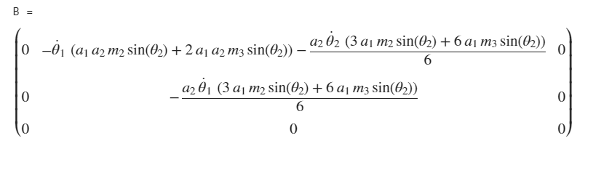
Velocity Coupling Vector
Coriolis Matrix
$$V=C\left(q,\dot{q}\right)\dot{q}$$
$$B= \frac{∂M}{∂q_{i}}\dot{q}$$

Slide 31



Velocity Coupling Vector
Centrifugal Coefficients Matrix
$$V=C\left(q,\dot{q}\right)\dot{q}$$
$$C\left(q,\dot{q}\right)=B−\frac{1}{2} B^{T}$$

Slide 32
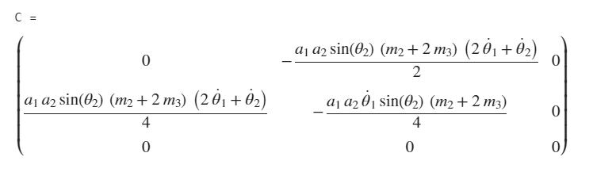
Velocity Coupling Vector
Centrifugal Coefficients Matrix
$$V=C\left(q,\dot{q}\right)\dot{q}$$
$$C\left(q,\dot{q}\right)=B−\frac{1}{2} B^{T}$$

Slide 33
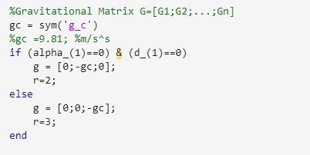
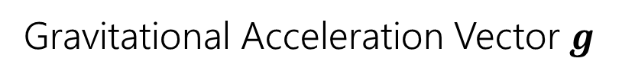
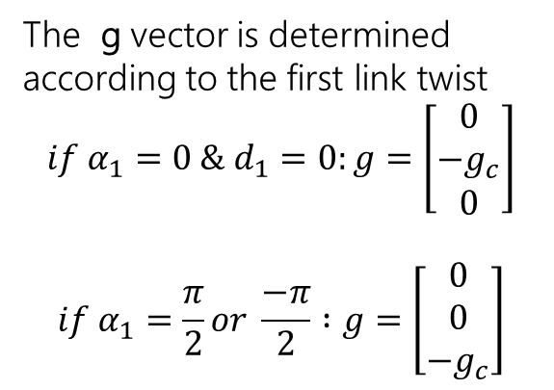
Gravitational Vector
Gravitational Acceleration Vector $g$
The g vector is determined according to the first link twist
$$if α_{1}=0 \& d_{1}=0:g=\left[\begin{matrix}0 \\ −g_{c} \\ 0\end{matrix}\right]$$
$$if α_{1}=\frac{π}{2}or \frac{−π}{2} :g=\left[\begin{matrix}0 \\ 0 \\ −g_{c}\end{matrix}\right]$$

Slide 34
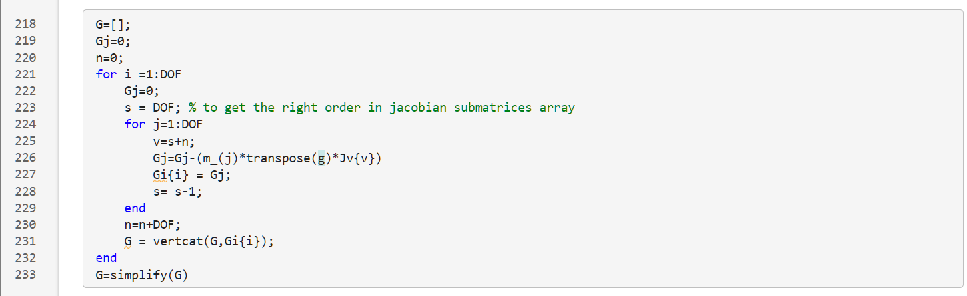
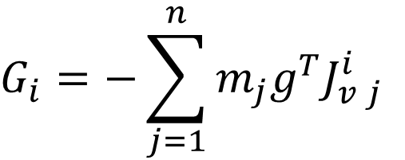
Gravitational Vector
$$G_{i}=−\sum_{j=1}^{n}{m_{j}g^{T}J_{v j}^{i}}$$
Gravitational Vector

Slide 35
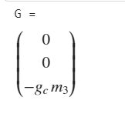
Gravitational Vector
$$G_{i}=−\sum_{j=1}^{n}{m_{j}g^{T}J_{v j}^{i}}$$
Gravitational Vector

Slide 36
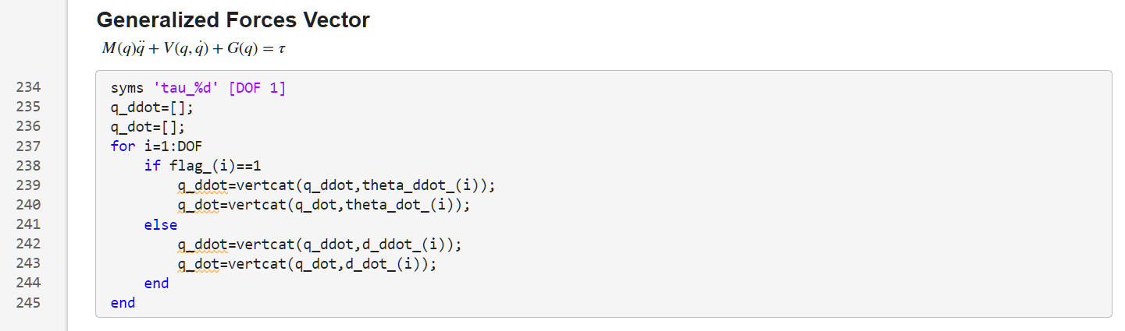
Generalized Forces Vector (Result)
Selecting the variable parameters
Selecting the variable parameters

Slide 37

Generalized Forces Vector (Result)
Selecting the variable parameters

Slide 38

Generalized Forces Vector (Result)
Generalized Forces Vector
$$M\ddot{q}+V+G+F=τ$$

Slide 39

Generalized Forces Vector (Result)
Generalized Forces Vector
$$M\ddot{q}+V+G+F=τ$$

